Slide 1

Wrap-Up: Key takeaways from the semester
Rayid Ghani and Kit Rodolfa

Slide 2
Reminders
Due next week:
1-page writeup
Peer contribution survey
Anonymous feedback to us

Slide 3
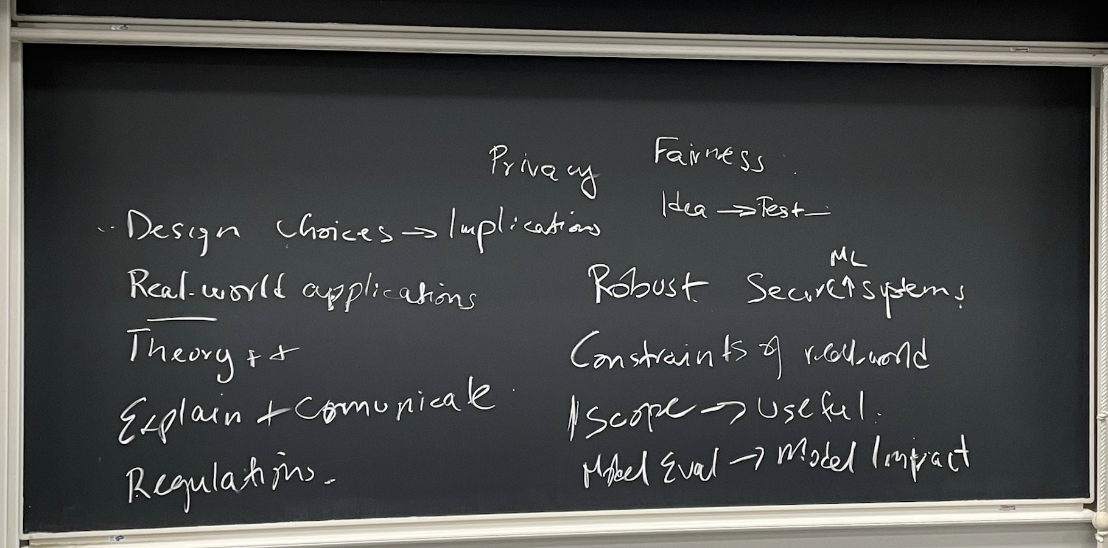

Slide 4
What we want(ed) you to learn from this class
How to responsibly and effectively solve real-world problems using ML
Understand the *entire* Machine Learning process (and get hands-on experience doing most of it)
Build (and use) reusable ML pipelines
Learn how to formulate ML problems, use, understand, evaluate, and communicate ML methods (that you have covered in earlier classes) in the context of a real problem

Slide 5
Seven Big Takeaways

Slide 6
All Your Modeling Decisions
Should Reflect How
It Will Be Used
What is your goal (it’s not to build a model)? Constraints?
What are you trying to generalize to?
Who/what is this model going to be applied to? When?
What’s the right metric for “accuracy” (rarely is this AUC or F1)?
What does fairness mean in this context?

Slide 7
Remember to Think
4th-Dimensionally
(Time Matters)
When is your prediction being made?
What information is available for features at that time? What isn’t?
How frequently will the model be updated?
Over what time horizon is your label occurring?
Leave time to collect labels between training and validation

Slide 8
Data != Matrix
Data doesn’t come with labels, you have to create them
Data doesn’t come with features, you have to construct them
Rows in the raw data are rarely the rows in the training/validation matrix

Slide 9
The Defaults Are
Mostly Bad
(aka Models Don’t Give 0/1 Labels)
Models give scores not predicted classes, and these are rarely probabilities
There’s no such thing as absolute accuracy, precision, or recall
A 0.5 score threshold is almost never what you want
Hyperparameters matter and defaults in many packages aren’t great

Slide 10
Compared To What?
What is the right baseline that your model needs to beat to be useful? By how much?
How is this decision currently made (or what commonsense, non-ML approach could be used)?
What is the performance of the current, human-driven decision-making process? How fair is it?
Do explainability methods give you more information than crosstabs and feature importances?

Slide 11
Be Skeptical
Most published results are overstated (at best), not tested on real-world uses
Try things out for yourself, understand their limitations in your context/use case
Interpretability is far from a solved problem. So is algorithmic fairness.
… or for that matter, generalizing to the future, top k classification, etc.

Slide 12
Models Encode Values
Be explicit about what you want the model to do
… and validate that the model actually does this
Understand (and seek out) the perspectives of different stakeholders, people affected by model
Goal is to have a fair overall system, not just a fair model

Slide 13
Class Recap
Scoping
Data Acquisition
Data Storage
Data Linkage
Data Exploration
Analytical Formulation
Modeling
Evaluation Metrics
Train Test Splits
Feature Generation
Baselines
ML Pipelines
Model Selection
Interpretability
Bias/Fairness
Field Trials
Deployment
Maintenance & Monitoring

Slide 14
Recap of Module I
Scope: Goals, Actions, Data, Analysis, Ethics
Data: Getting, storing, linking, exploring, and understanding
Formulation: Rows, Labels, Time, Metric, Baselines
Pipeline: Rows, Labels, Features, Train-Validation Pairs, Metrics, Models + hps
Model Selection:
Run Experiments
Analyze results to choose best model
Iterate

Slide 15
Many Bias Measures: How do we select what we care about?

Slide 16
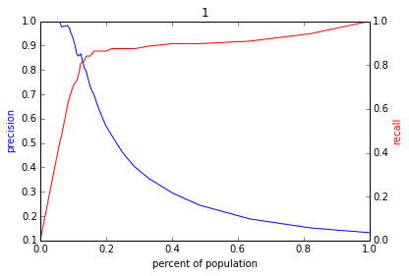
Varying the Threshold – Budget Menu
Score
1 .9 .8 .7 .6 .5 .4 .3. .2 .1
| | | | | | | | | |
Baseline

Slide 17
Interpretability Use Cases
Use Case | User | Task | Global or Local
Debugging | ML Developer | Sanity check and improve “correctness” | Both
Improving performance | Action- taker | Decide to agree or override | Local
Trust | Policymaker/Action-Taker | Model use => better outcomes | Both
Interventions | Action-Taker | Improve outcomes | Local
Recourse | Individual(s) affected | Provide information that the individual can understand and ideally change | Local

Slide 18
Data and AI Ethics Issues
Privacy
Data Ownership
Bias, Equity, & Fairness
Transparency
Trustworthiness and Accountability

Slide 19
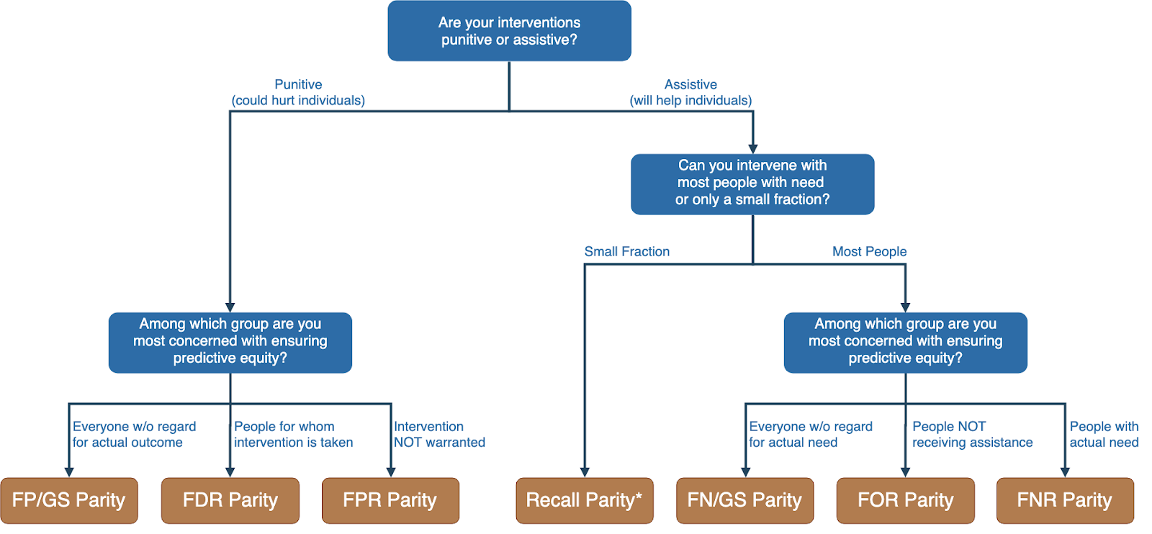
Translating policy goals to fairness metrics

Slide 20
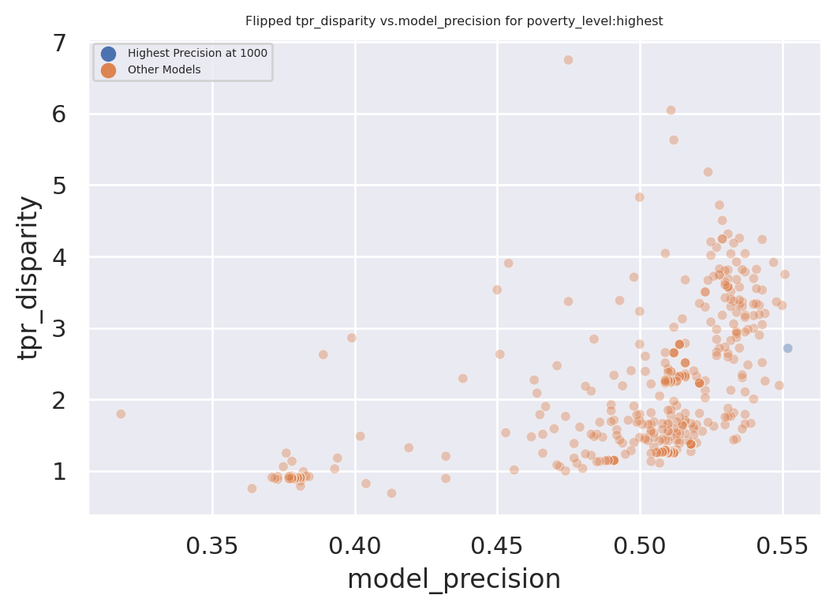
Dual Goals: Fairness and Accuracy
Disparity
Our hope:
Fairness-improving
methods can expand this
frontier by adding new
points
Precision@k

Slide 21
Scope: what’s your goal?
Analytical Formulation: What are you predicting, for whom, when, how often, for and for what purpose?
baselines
What and when is a row? What and how far out is the label?
Features do not come with the data – you need to create them. They need to include not just information about the entity you’re predicting about but also about the context they’re in – compared to similar entities, in the recent past, in nearby places
What do you want to generalize to? Future? To a new geography? To a new domain? K-fold is rarely the right model selection method.
Leaving time for labels

Slide 22
Modeling: hyperparameters matter. Need to understand which ones to vary and what range. Rfs, LR, Dt, boosting, …
Models do not give 0/1 classification – they give a score that is rarely a probability. Do not use argmax or predict function in sklearn
Metrics: there is no such thing as absolute accuracy, precision or recall. It depends on the threshold. 0.5 is a bad threshold in general but often assumed in ml packages.
AUC can be useful but not in most problems.
Pr-k curve
Model selection
Interpretability – using simple models to debug. Print them out,. Cross-tabs
Bias and fairness
trials

